Slide 1
NAAN MUDHALVAN SCHEME
Project Name:
Fundamental Of Data Literacy With Tableau
Project Title:
Analysing Housing Prices In Metropolitian Areas Of India
Team ID:
NM2023TMID09478
Team Lead ID:
612D6B75E8158D6B9F94E936C6A08D2F

Slide 2
Team Members ID:
448A4CE4D9E6846969A463E6AE3AD032
612D6B75E8158D6B9F94E936C6A08D2F
6FEFEDC11C50FFB894B4A3DCAA7495FC
EE020687E58B18AAF9246A3367BABE6C
Introduction:
House price prediction in a metropolitan city in India is a valuable solution for potential home buyers, real estate agents, and investors. By leveraging historical sales data, property details, and location-specific information, a predictive model can accurately estimate house prices. The model's scalability, real-time updates, user-friendly interface, and transparency ensure it meets the needs of stakeholders. Integration capability, data privacy, and cost-effectiveness are also important considerations. By addressing these requirements, the prediction model provides reliable insights, empowering stakeholders to make informed decisions in the fast-paced real estate market.

Slide 3
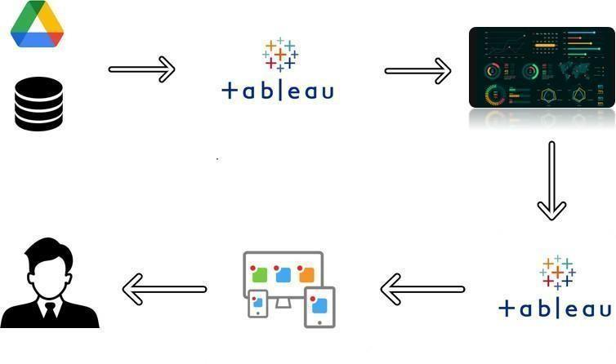
Technical Architecture:

Slide 4
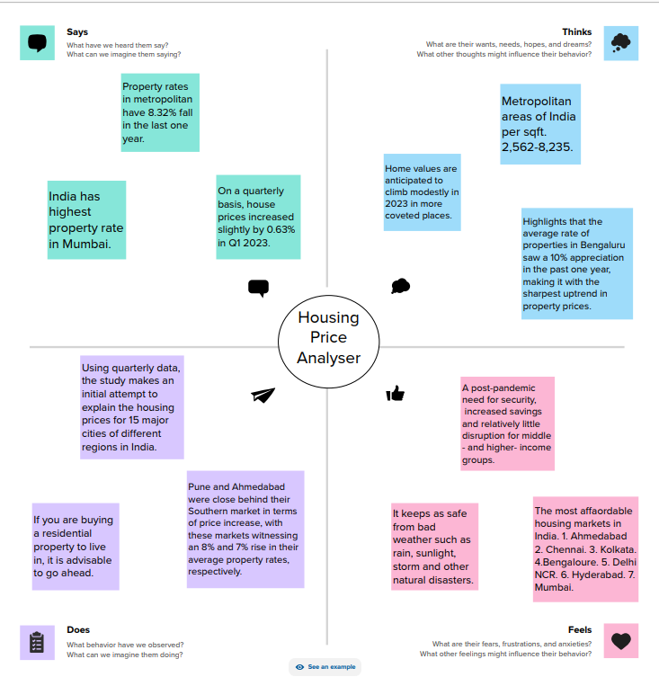
1. DEFINING PROBLEM
Empathy Map

Slide 5
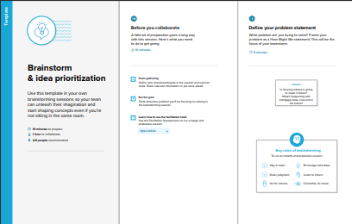
Brainstorming

Slide 6
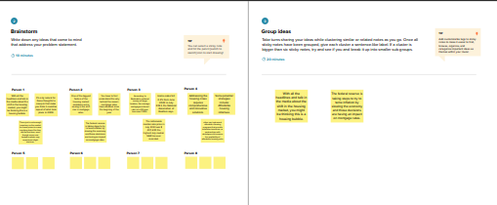
.

Slide 7
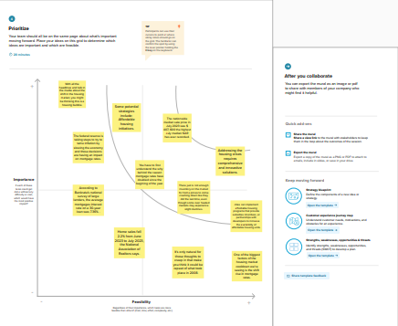

Slide 8
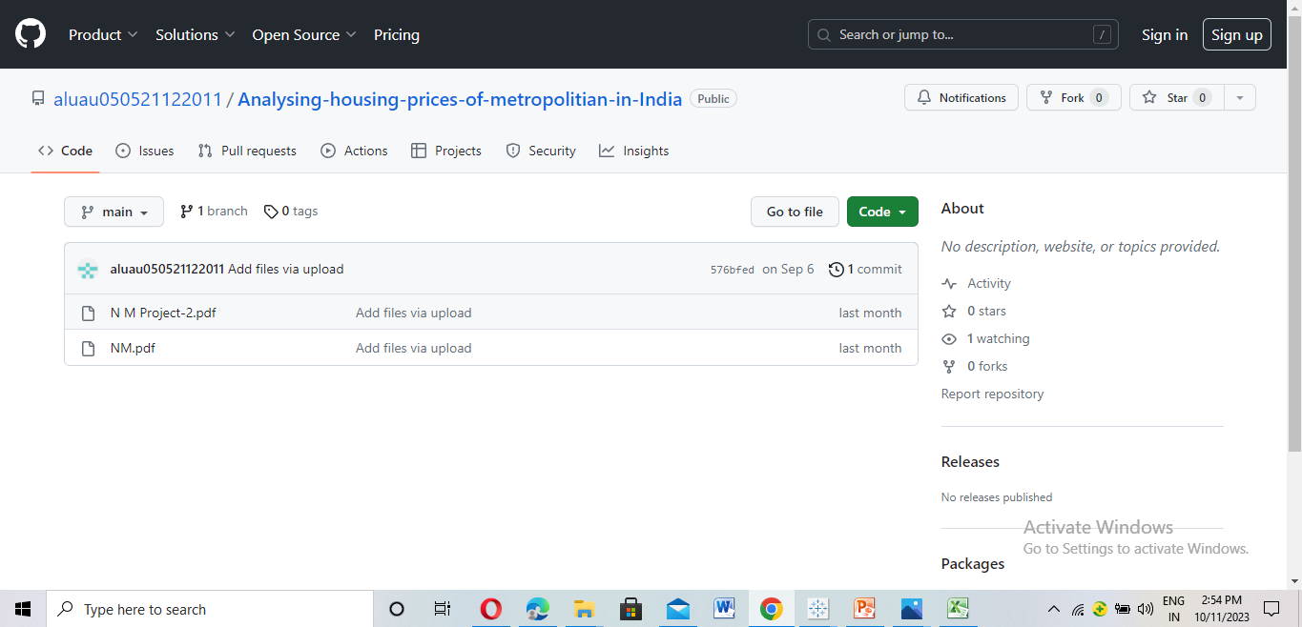
Uploaded Empathy Map and Brainstorming On GITHUB

Slide 9
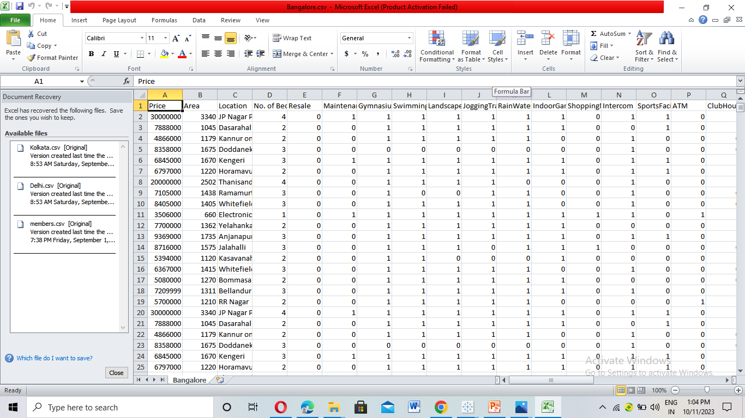
2. DATA COLLECTION AND EXTRACTION

Slide 10
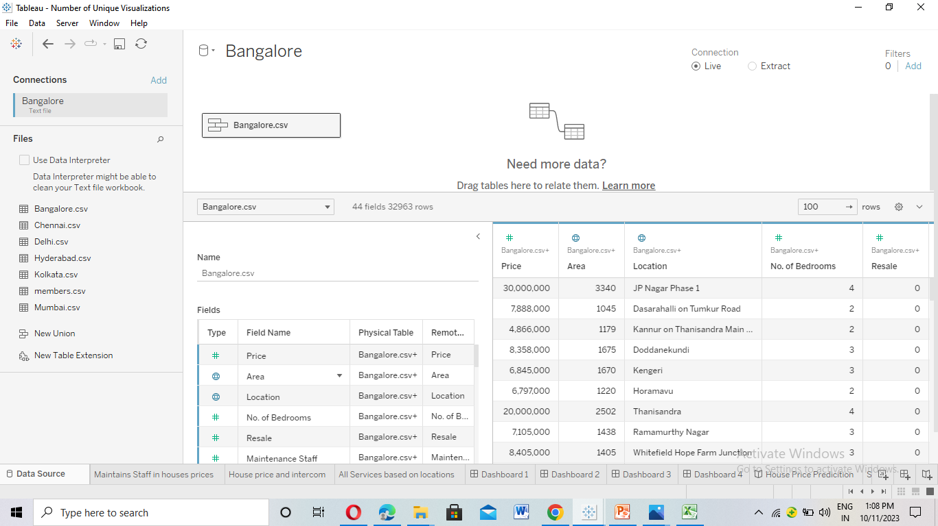

Slide 11
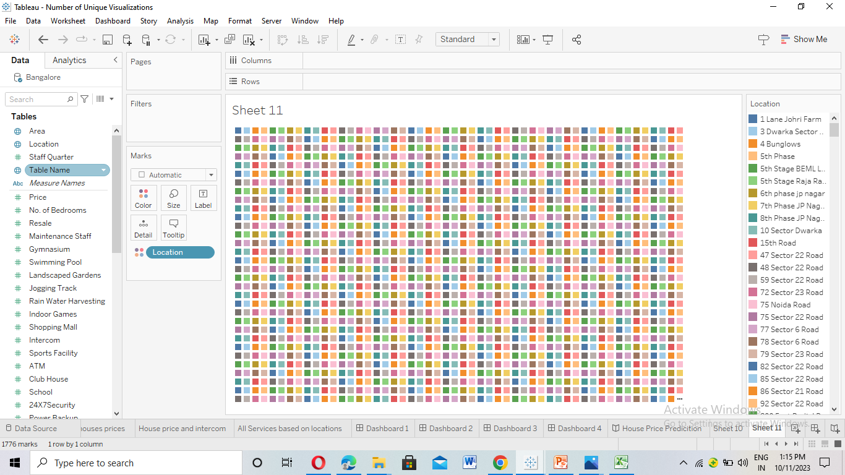
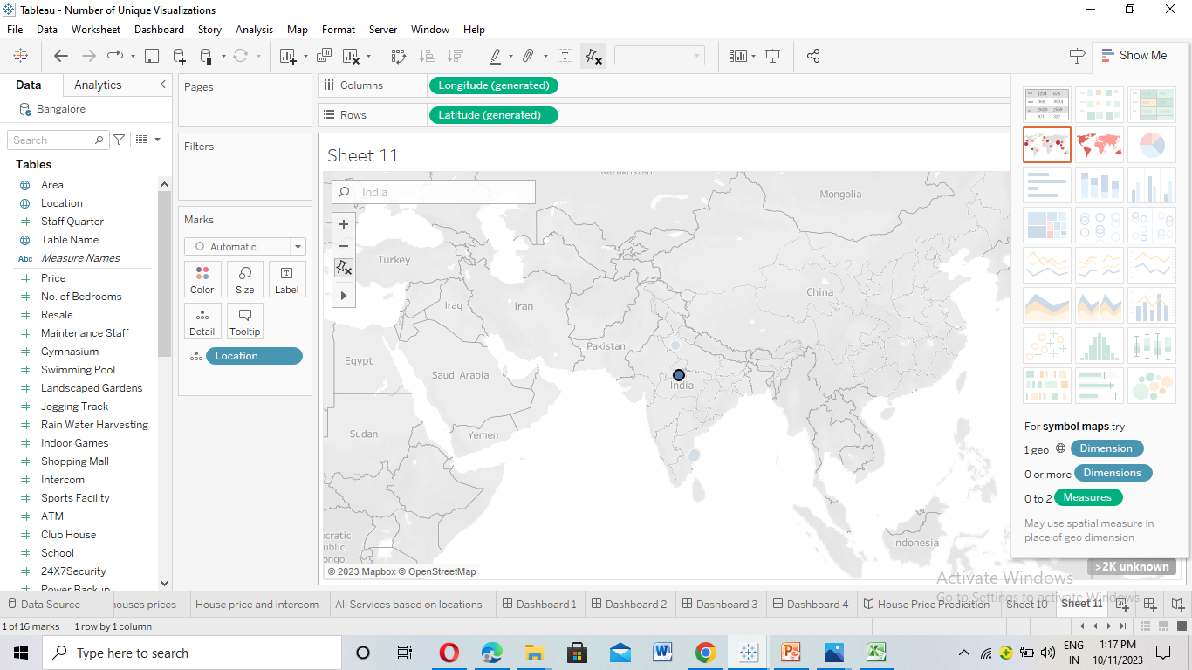
3.DATA VISUALIZATION

Slide 12
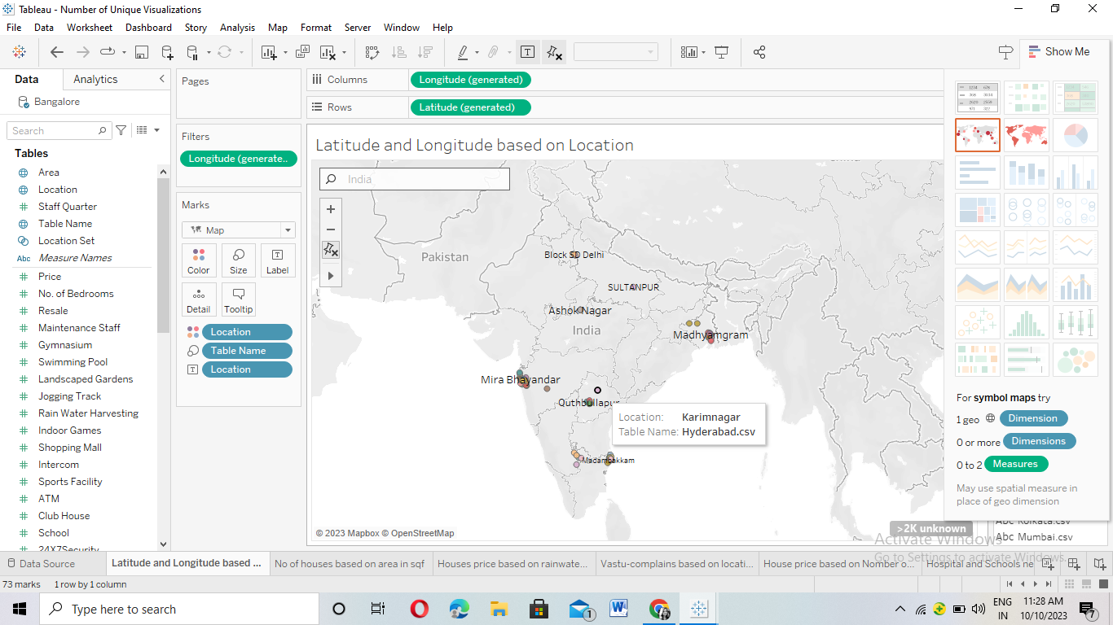

Slide 13
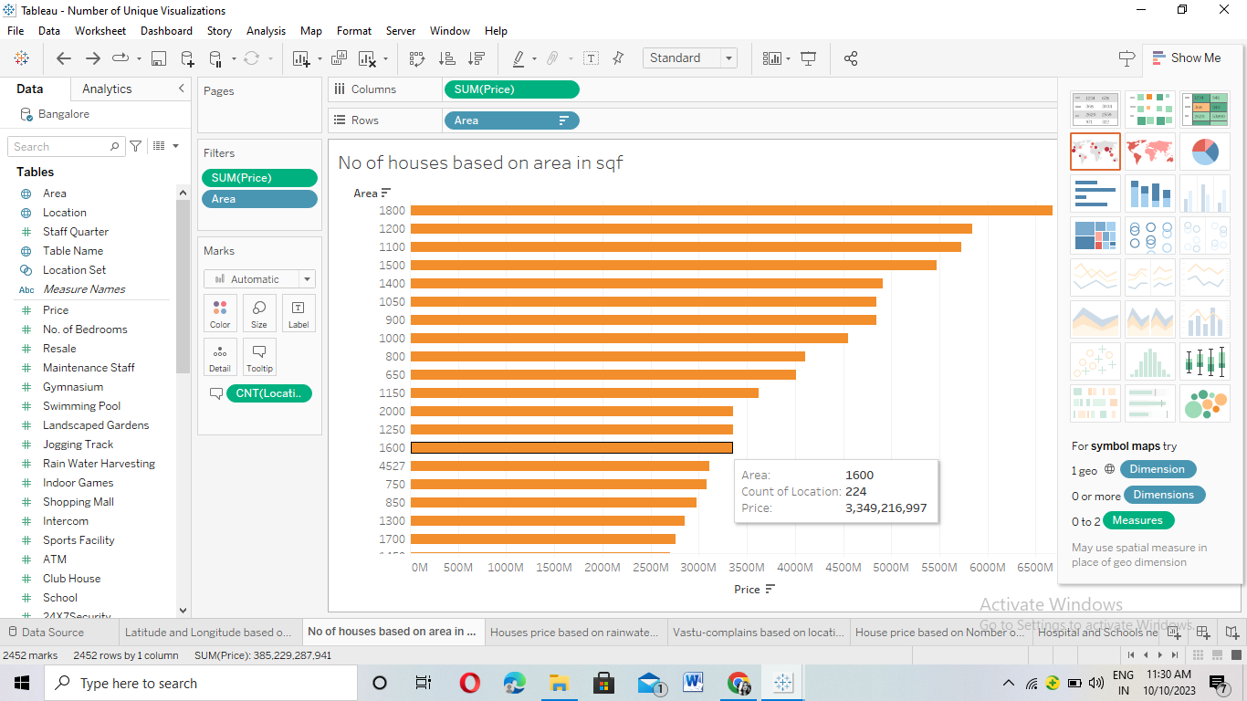

Slide 14
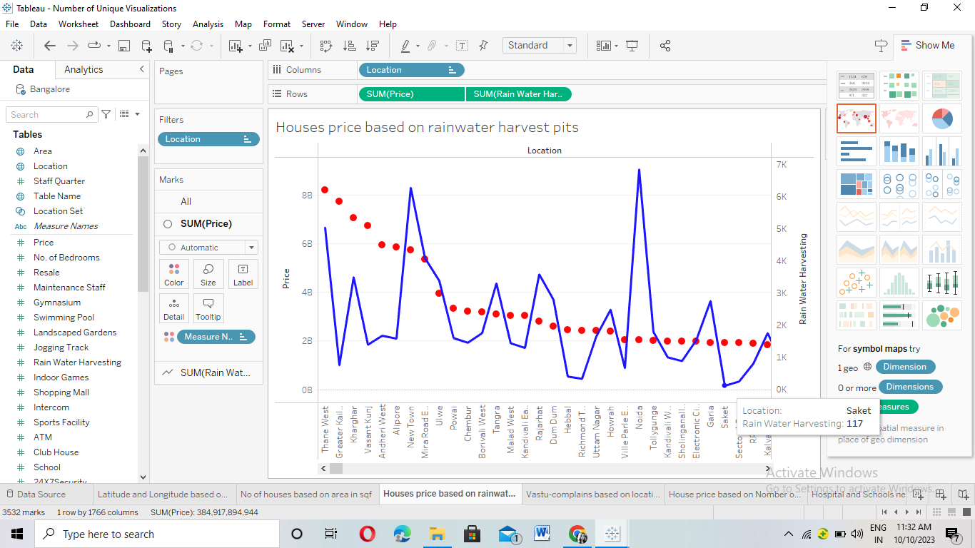

Slide 15
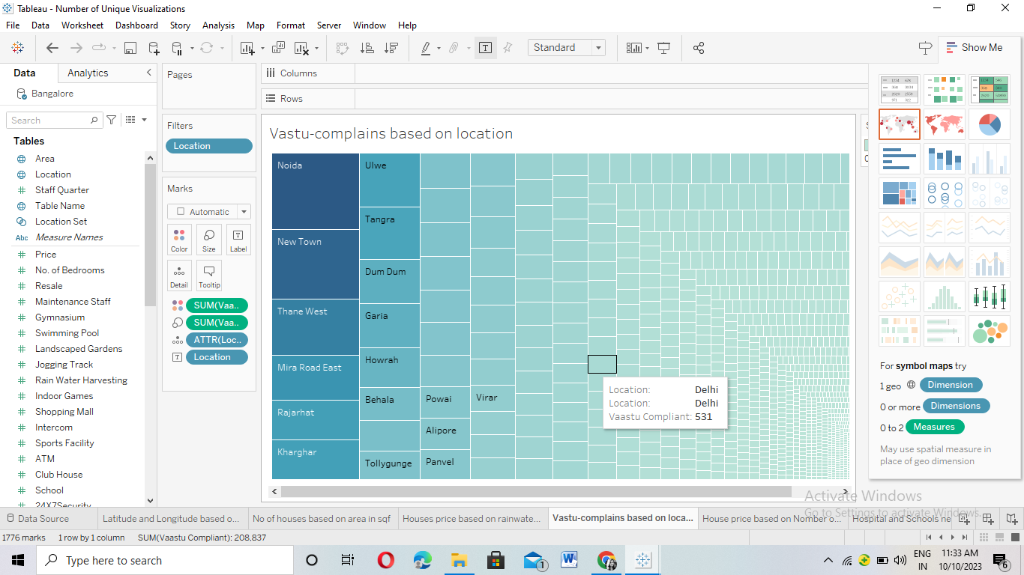

Slide 16
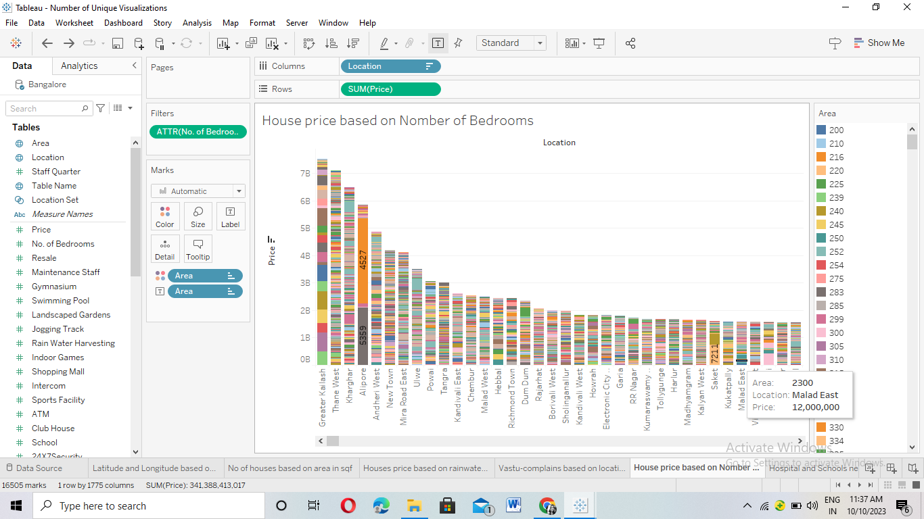

Slide 17
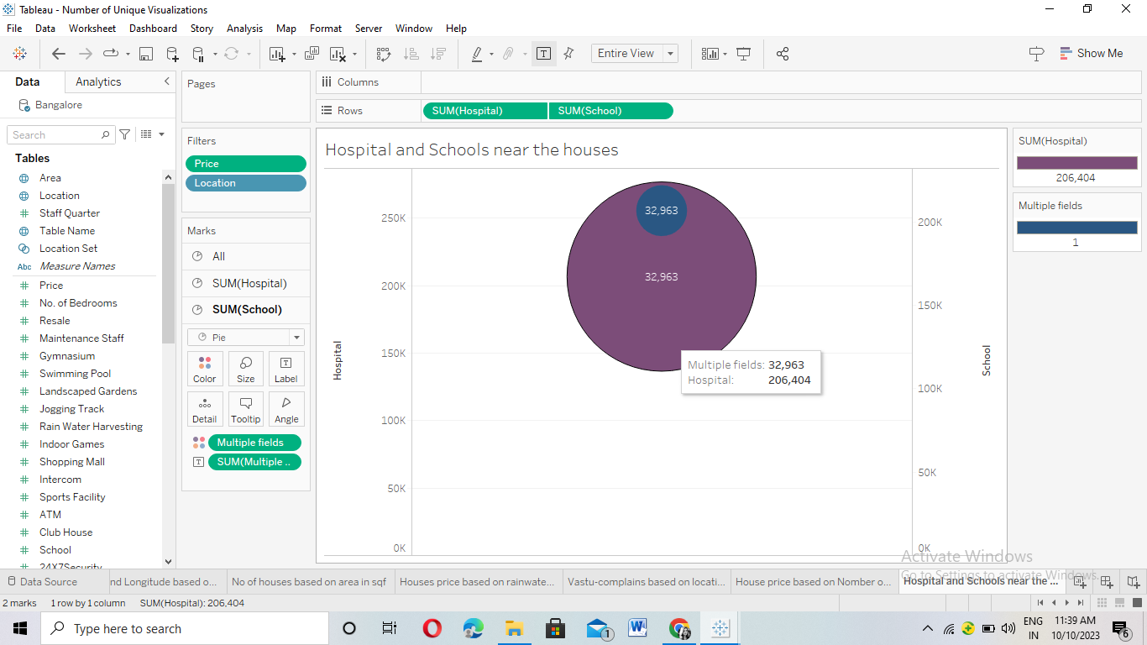

Slide 18
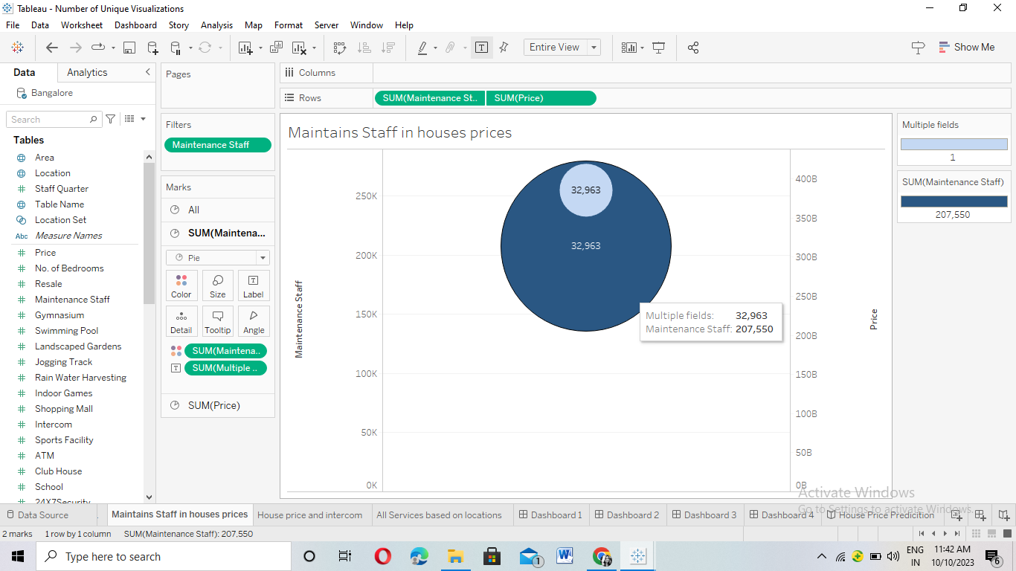

Slide 19
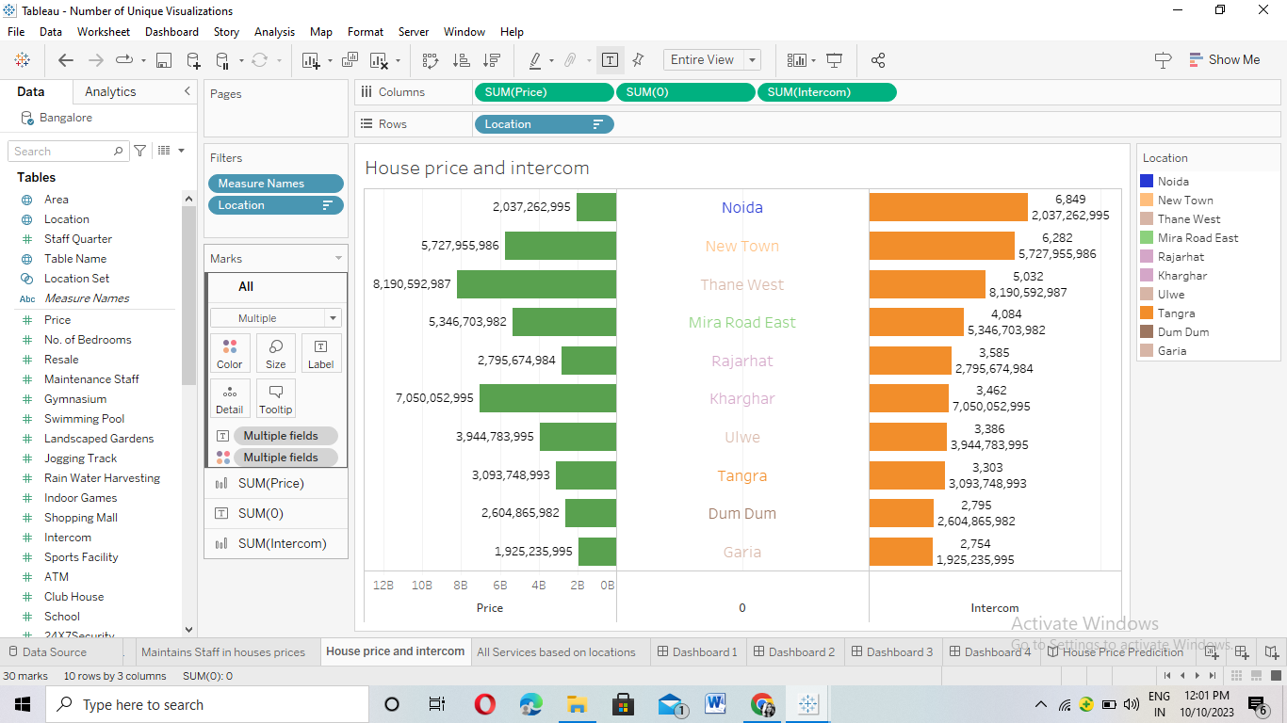

Slide 20
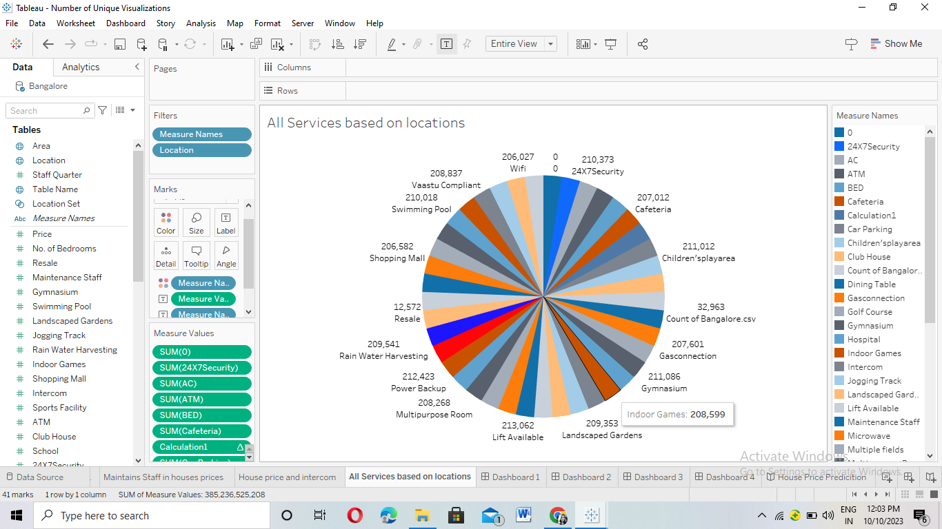

Slide 21
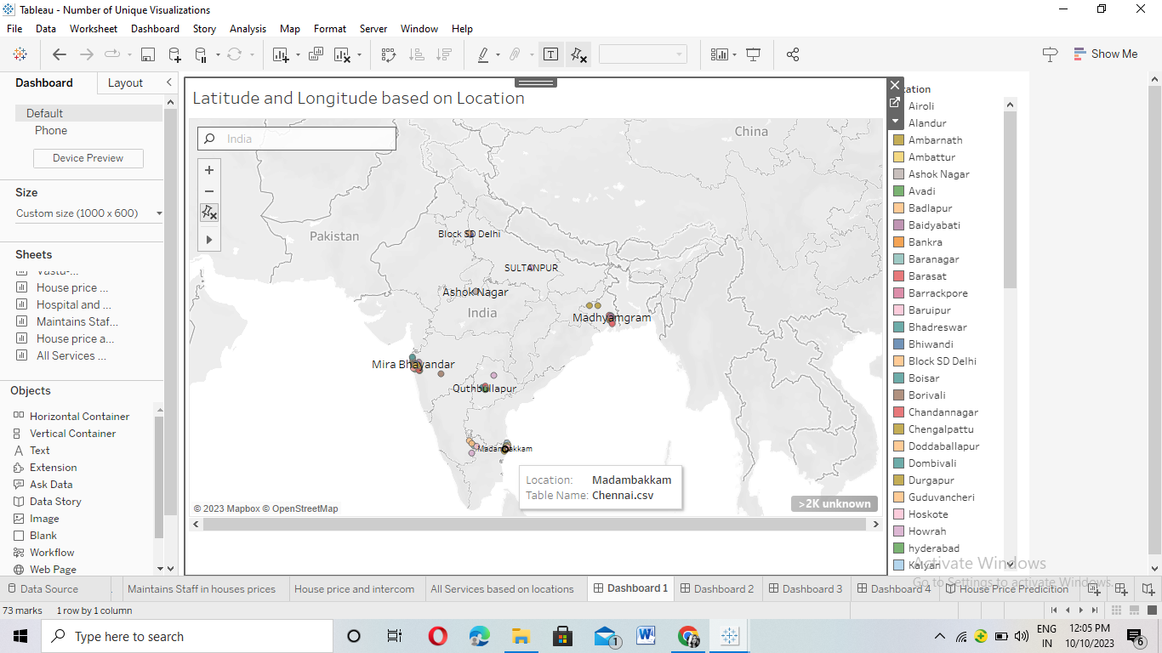
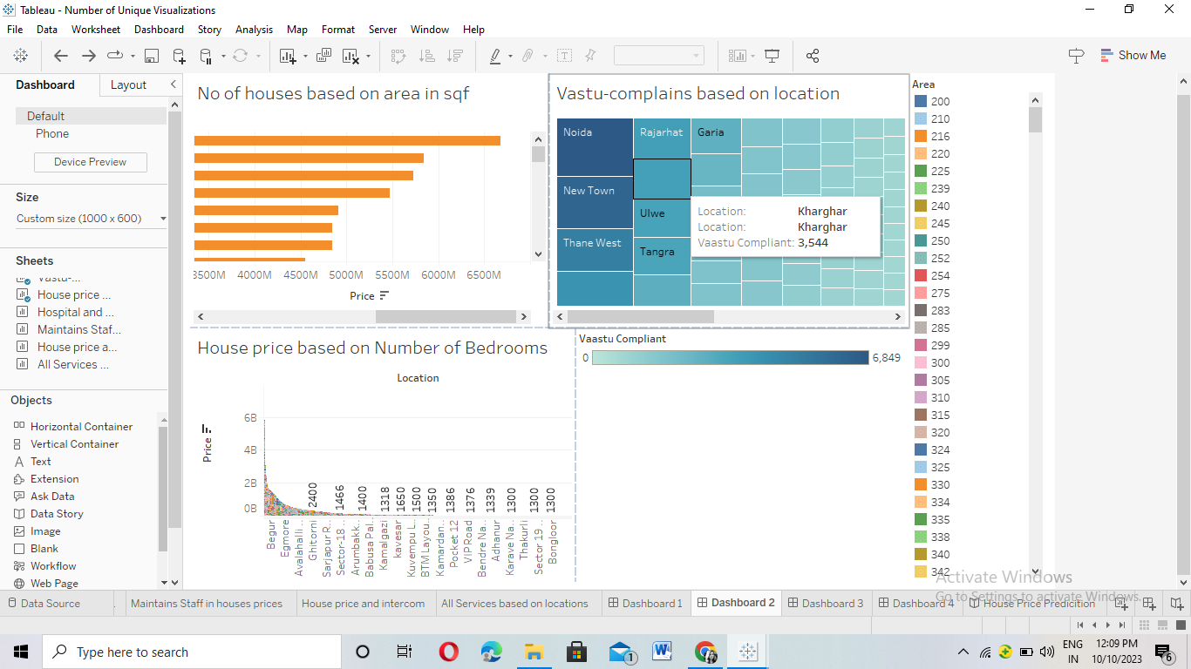
4.Dashboard

Slide 22
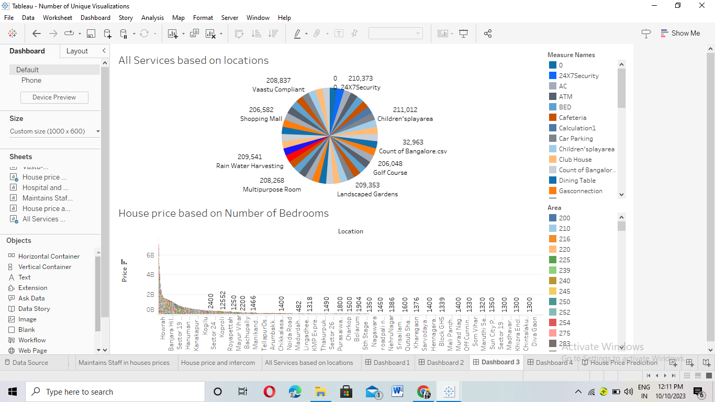
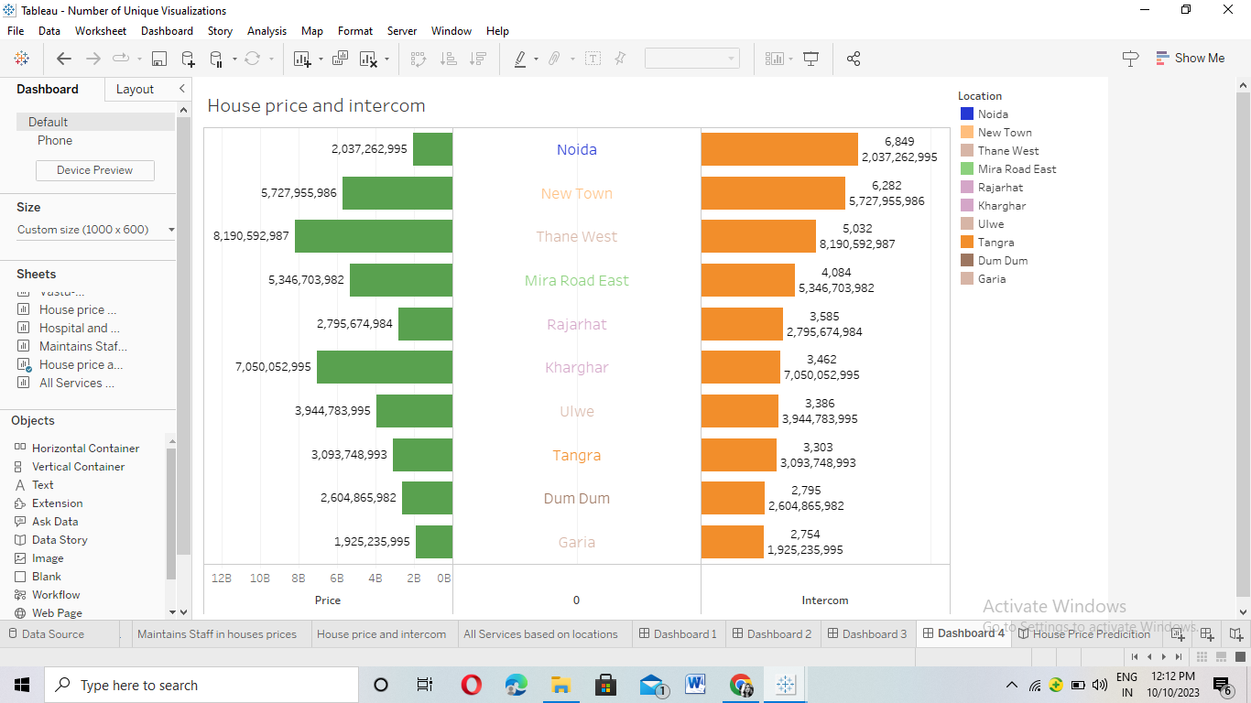

Slide 23
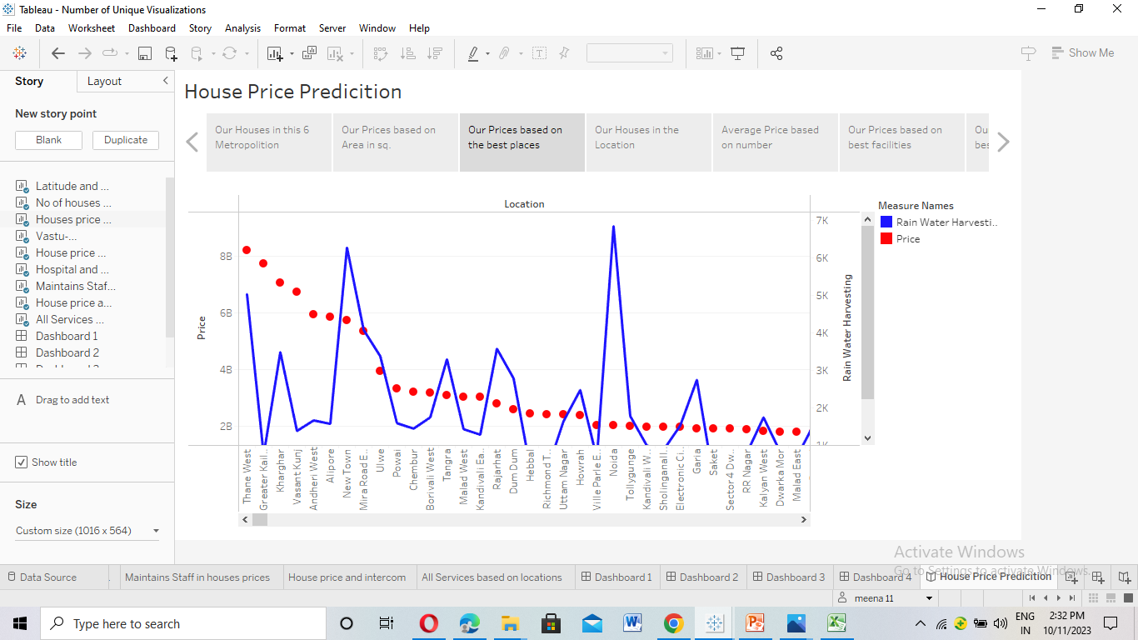
5. story

Slide 24
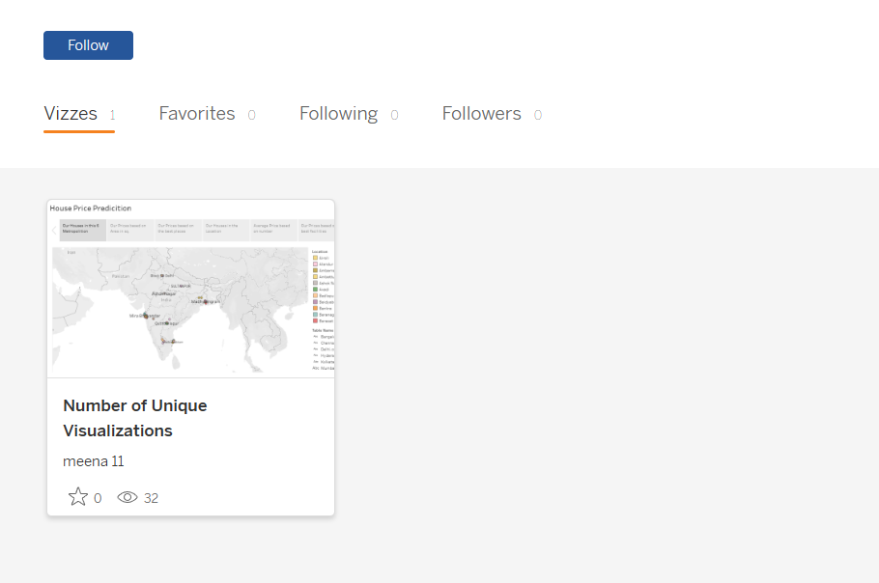
Finally published in Tableau Public

Slide 25


